Slide 1
Tuesday, September 13, 2016
Write In Your Agenda:
Write In Your Monitoring Log:
CW:
Continental Drift vs. Plate Tectonics: A Comparison of Two Theories
HW:
None.
Response to Warm-Up:
Name & describe one type of evidence that proves Pangaea existed.
You will need:
Pencil
“What is Pangaea?” Note Sheet
Hand in signed Monitoring Log.

Slide 2
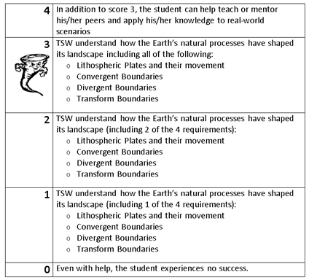
Learning Goal and Scale
TSW understand how the Earth’s natural processes have shaped its landscape (including Lithospheric Plates and their movement, Convergent, Divergent, and Transform boundary landforms).

Slide 3
*Read/research Continental Drift (pink sheet) and Plate Tectonics (green packet)
*Complete yellow sheet and keep it when finished
*Return reading sheets to counter when done
*Work on word search.

Slide 4
https://www.youtube.com/watch?v=KCSJNBMOjJs

